Slide 1

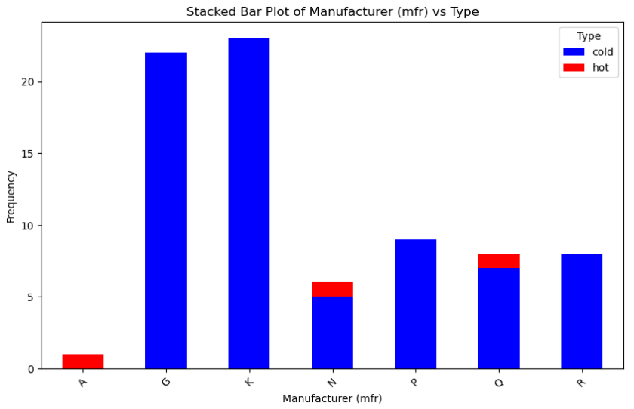
Consumer Preferences and Manufacturer Frequency for Hot v. Cold Cereal Types
Data finds that consumers generally rate hot cereal types higher than cold
cereal types. Despite this, production is manufacturing of cold cereals is higher than hot cereals across many manufacturers such as General Mills, Kellog, Post, and Ralston Purina.
Key Findings:
Hot cereals have an average rating of above 45%, compared to cold cereals ranging from 10-100%
General Mills, Kellog, and Ralston Purina manufacturers do not produce hot cereals, where American Home Food Products does not manufacture cold cereal.
Quaker Oats has a higher frequency of hot cereal (oatmeal).
Despite the span of ratings of cold cereals most manufactures produce cold cereal at a higher frequency than hot cereal.
A = All American Home Food Products
G = General Mils
K = Kellog
N = Nabisco
P = Post
Q = Quaker Oats
R = Ralston Purina
Data Source: 80 Cereals (kaggle.com) “80 Cereals” | Kaggle

